Slide 1
Never Use 3DNR Camera Setting
Tony George IOTA 2020 Conference

Slide 2
Never use 3DNR noise reduction settings in video cameras
Many CCD video cameras using NTSC or PAL format have a setting called 3DNR. Here is a short list.
WAT910HX/RC
Mallincam
PC165DNR
RunCam Night Eagle Astro Edition

Slide 3
How 3D-DNR Improves Video Noise Reduction
Much of the following four slides is excerpted from an article posted on March 14, 2013 in Security Cameras
The chip inside your camera is constantly picking up noise from interference and byproducts produced by other circuits and electronic components within it. These noise artifacts can translate into images and video as fine static, snow or fuzzy images.
Digital Noise Reduction (DNR) is a method by which the camera’s imager digitally removes noise from the image. 3D DNR is an advancement of this technology which enables noise to be filtered even more effectively from the image, even in low light conditions.

Slide 4
‘Traditional’ DNR
Traditional DNR technology utilizes temporal noise reduction. This technique basically compares one frame to the next and removes any tiny specs in each frame that do not match. The idea is that by blending the frames, the overall noise content in an image is reduced.
Generally, traditional DNR only removes the noise and unwanted data found in the “front” of a scene. This means that only the objects in the foreground of the scene are processed to reduce the visual noise, and anything in the background remains unprocessed.
A good example of this is viewing a parking lot at night from a business. Objects that are closer to the camera, such as vehicles or people approaching the camera are “processed” to remove unwanted noise and snow. Any object in the background is unprocessed for digital noise and appears snowy.
This ‘Traditional’ approach can affect an occultation video if the stars are bright, as they will be considered foreground objects and the sudden light reduction of the occultation can be interpreted as unwanted noise.

Slide 5
What’s Different About 3D DNR
3D DNR takes traditional DNR technology a step further. Not only does 3D DNR handle the traditional frame-to-frame noise reduction, but it also incorporates spatial noise reduction.
Spatial noise reduction compares a pixel with its neighboring pixels to detect and remove unwanted noise found within the frame. It processes the entire image to remove digital artifacts and grainy appearance while better maintaining image clarity and sharpness.
3DNR is particulary troublesome for occultation astronomy because it affects faint stars over many frames, trying to keep them from fluctuating too drastically. For an occultation, this has the effect of applying a running average type of adjustment to faint stars, which causes D and R events to be ‘gradual’ rather than instantaneous.

Slide 6
From Supercircuits

Slide 7
Normal Occultation light curve w/o 3DNR
Paul Maley
(670) Ottegebe
Occultation
2020-06-27
D and R are instantaneous – light curve noise looks normal

Slide 8
Occultation light curve w/3DNR
Paul Maley
(174567) Varda
Occultation
2018-09-10
Note how variations in light intensity fluctuate in very similar up/down patterns with gradual D and R

Slide 9
(174567) Varda occultation
Varda is a TNO and the observation was made as part of the Lucky Star Project.
The Varda observation was problematic, as it caused the D and R to appear as gradual events and researchers in the Lucky Star project thought it might be evidence of an atmosphere around Varda.
Initially, we thought the gradual D and R were due to changes made in Paul’s capture hardware, as he recently had changed to a new FireWire capture card.
Dr. Bruno Sicardy, Dr. Philipe Braga Ribas, and Dr. Damya Souami spent a great deal of effort researching what might have caused the gradual D and R, if not an atmosphere.

Slide 10
Eric frappa provides clarity of the problem
Eric Frappa, European Coordinator for IOTA, had seen similar behavior in other videos and traced it to 3DNR. Here is an excerpt of his explanation:
I have been able to reproduce exactly the same behavior than in Paul's video, using a 3DNR filter set to ON at 50% level (which is the default setting of the 910HX): in applying abrupt corrections with the hand controller on the star field centering, duplicated images of the faint stars appear when there is no duplicated images for the bright stars. These "ghost" images of the faint stars located at the position before correction fade gradually and disappear when, at the same time, the images of the faint stars at their new position brighten to their normal value. The same test shows no anomaly when performed with the 3DNR filter set to OFF .

Slide 11
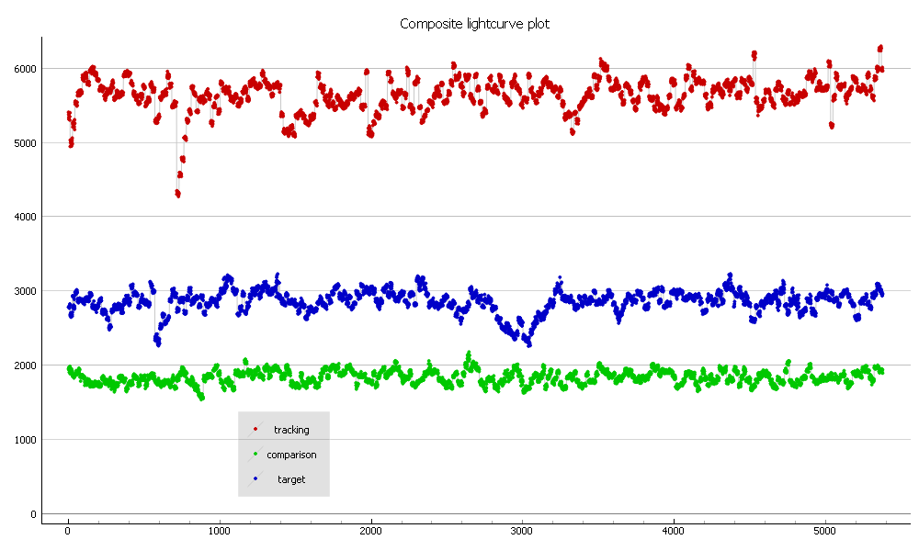
Tony George serendipitously confirms the diagnosis
After the research performed by the Lucky Star researchers and the IOTA-ES Coordinator, I accidently observed the same problem with several of my observations.
I had recently moved to a new home in Scottsdale, AZ and many of my observations were made on very hot evenings looking directly over the roof of my home. The resulting light curves were very ‘wavy’ and D and R transitions were very gradual. Here is a light curve from my (229) Adelinda recorded on 2020-06-17.
Blue data points are for the target star.

Slide 12
Tony George serendipitously confirms the diagnosis
Since I knew from the Varda occultation that gradual events could be caused by 3DNR, I checked my WAT910HX camera and darn if it wasn’t set with 3DNR-ON!
It turns out that any time you ‘Reset’ the WAT910HX, it automatically reverts to 3DNR-ON. It would have been easy for both Paul and I to accidently reset our cameras, as the reset menu is very close to other commonly used menus and who knows what people do in the dark!

Slide 13
Moral to the story
Never use 3DNR setting on your camera if you have that feature
If you use a WAT910HX camera, be sure and change 3DNR to OFF if you ever perform a reset.
Check you WAT910HX camera occasionally in case you might have inadvertently reset your camera and turned 3DNR back ON.

Slide 14
Thanks
Paul Maley for allowing the use of his light curves
Dr’s Bruno Sicardy, Philipe Braga Ribas, and Damya Souami for their persistent pursuit of the cause of the gradual D and R in the Varda occultation
Eric Frappa for providing the insight into what caused the gradual D and R in the Varda light curve

